Slide 1

Health Emergency Preparedness Response and Resilience
MPA Program
4th Implementation Support Mission
IGAD Presentation
July 2026

Slide 2
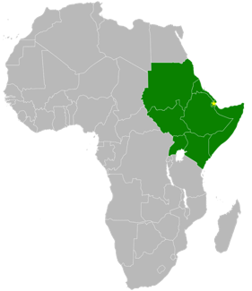
Intergovernmental Authority on Development (IGAD)
IGADD in 1986 to cope with famines in the region
IGAD Transformed and widened its objective to Development: 1996
Regional Economic Community (REC) of African Union
Coverage: East and Horn of African countries
Headquarter: Djibouti City
Total Population: Over 270m, 17% Africa’s Landmass, 70% is Arid and Semi-Arid Land Areas
Over 20% of the population live in the cross-border areas
Most countries generally characterized with fragile Public Health system

Slide 3
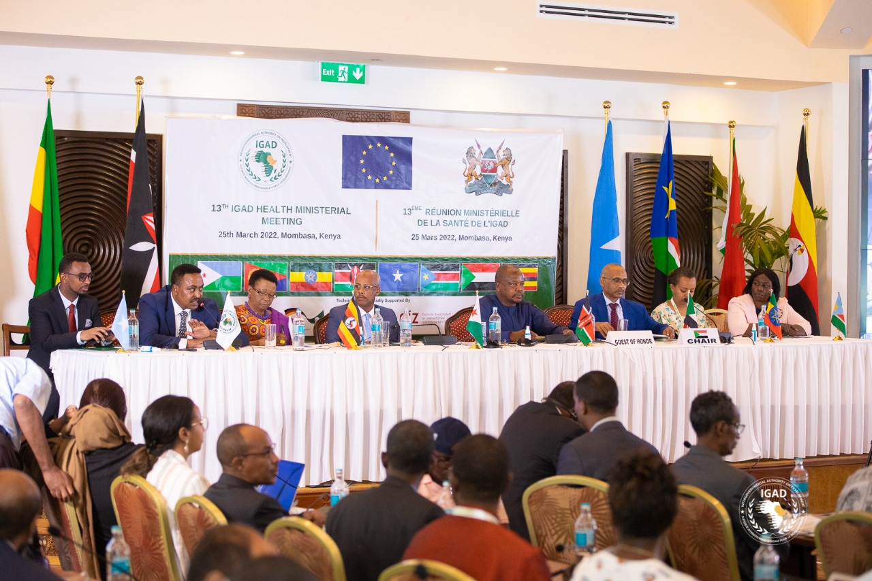
Governance Structure of (IGAD)
Robust Governance structures
  Summit – Heads of States and Governments
  Council of Ministers
  Committee of Ambassadors
  IGAD Secretariat
  Sectoral Ministerial Committees (e.g. Health, Livestock, Environment, etc)
  Sectoral steering committees
  Technical platforms, including Cross Border points

Slide 4
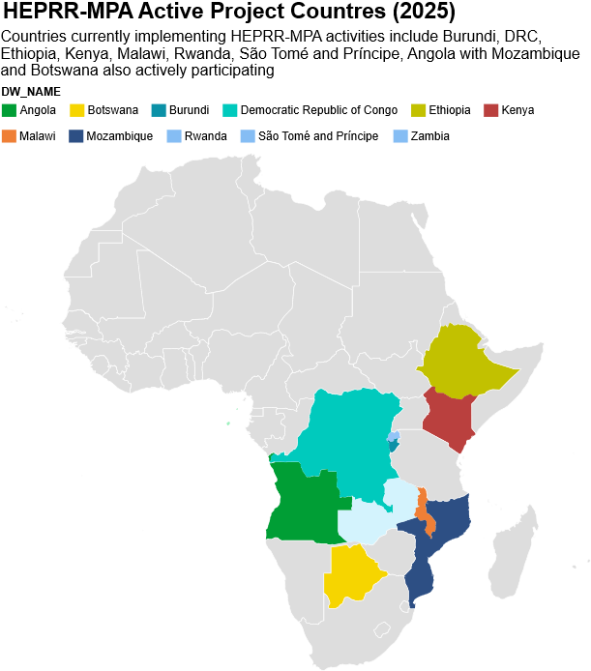
Program Development Objective
To strengthen health system resilience and multisectoral preparedness for responding to health emergencies in Eastern and Southern Africa.

Slide 5
Project Data
Description | Date
IGAD Financial Agreement Date | 7th December 2023
Effectiveness date | March 7, 2024
Closing Date of the Project | September 30, 2030
Project Amount | Us$ 19 Million (OF & AF)
Disbursement up to June 2026 | US$ 8,714,663 (46% of the project amount)
Burn rate: (expenditure vs. funds received) | US$ 6,024,801 (69% of the disbursed amount)

Slide 6
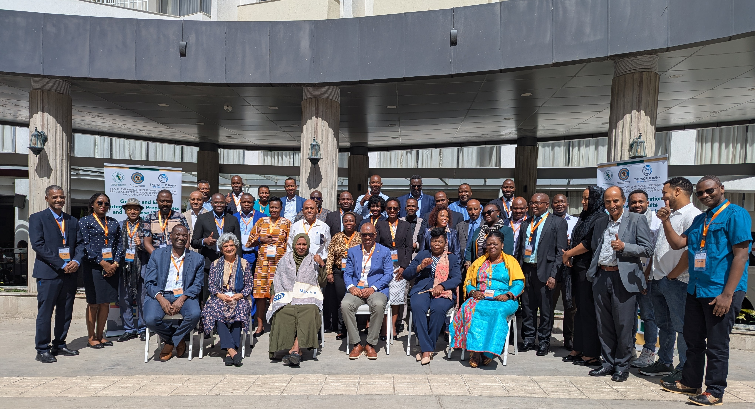
Strategic Focus of The IGAD Regional Component
Climate and Health
Workforce development
Local Manufacturing
Cross border collaboration
Collaborative Surveillance
NCDs and Mental Health
Gender and Equity integration

Slide 7
Delineation of Interventions
IGAD Policy, harmonization, and high-level coordination Climate and Health and One Health Human resources development on aspects of technical areas under the IGAD. Policy matters related to HRH under IGAD but the lead is ECSA-HC Access to quality health commodities, local vaccine and pharmaceutical manufacturing Gender and equity consideration Health information systems and digitalization but the lead is ECSA-HC Cross border collaboration and essential services continuity Mental health Psychosocial Support and NCDs Co-convening of RAC and Communities of Practice (COPs) (facilitate country & regional learning and knowledge exchange) – (Co-lead) | ECSA-HC Human resources development on aspects on technical areas under the ECSA-HC Health information systems and digitalization Communicable diseases surveillance, cross-border surveillance including PoE, AMR Laboratory systems improvement Management of emergency preparedness and response interventions including joint/intercountry response and essential services continuity Risk communication and community engagement (RCCE) and health information systems Coordinate M&E activities Co-convening of the RAC and selected Communities of Practice (facilitate country & regional learning and knowledge exchange) - (Co-lead)

Slide 8
IGAD HEPRR MPA 2026 Annual Work Plan: Implementation Progress (January–June 2026)
Status | No. of Activities | %
Completed | 15 | 28
Ongoing | 19 | 35
Planned for Jul–Dec | 20 | 37
Total AWP Activities | 54 | 100

Slide 9
Component 1:1
Strengthening the preparedness and resilience of regional systems to manage health emergencies

Slide 10
Component 1.1: Strengthening multisectoral collaboration and partnerships
Establish effective Partnerships: for implementation of MPA program
  MOUs with participating countries
  Signed with Mozambique
  Drafting and revision of the MOU with Botswana
  MOU with Angola not initiated yet (as last MOU)
RECs engagement:
  Participation of RECs in all IGAD regional activities including the virtual events
  IGAD is engaged in events organized by RECs (e.g COMESA-green manufacturing event)
  Inter-RECs meeting in coordination with SADC as Chair of RECs is planned for August 19 to 21 August in Addis Ababa (back to back with RC Ministerial meeting) with identification of local manufacturing as focus area for discussion

Slide 11
IGAD Emergency Ministerial Meeting on Ebola Virus Disease Outbreak Response
IGAD convened council of Health Ministers meeting virtually; 29th May, 2026
In Collaboration with regional Partner organizations; WHO, IFRC and Pandemic Fund Secretariat and AFCDC
EVD Declared as an event of regional concern
IGAD made a contribution USD 8.5 million for the regional support from the Pandemic Fund portfolio;
  7 Million (1 Million for each of the 7 member states)
  Additional 1.5 Million for Technical Assistance (TA) and Support for regional Coordination
  IGAD developed and disseminated EVD guidance note

Slide 12
Component 1.1: Strengthening multisectoral collaboration and partnerships
Climate and Health Nexus
  Development of framework for four key climate priorities for implementation through the Community of Practice (COP) for Climate and Health:
      Preparedness to climate shocks
      Risk profiling
      Predictive modelling
      Vulnerability assessment
  Climate and Health Expert recruitment has been concluded reporting on 1st August and plan for orientation is developed
  IGAD convened the GHACOF 72 Meeting
    MAM Forecasting done to enhance early warning systems
  COP 31 in Turkey: IGAD planning, Ministerial meeting for Climate and Health Ministers

Slide 13
Component 1.1: Strengthening multisectoral collaboration and partnerships
  Climate and Health Community of Practice (CoP) Virtual Progress Meeting, April, 2026
Participants endorsed three priority thematic areas to guide the work of the Community of Practice:
  Predictive Modeling. DRC
  Preparedness for Climate Shocks. Kenya
  Vulnerability Assessment and Risk Profiling. Rwanda
  Agreed to explore the feasibility of the 4th thematic area; covering Governance
Agreed Actions: The thematic working groups were requested to:
  Define their scope of work and objectives.
  Develop implementation roadmaps.
  Identify priority technical assistance needs
  Prepare presentations on their outputs

Slide 14
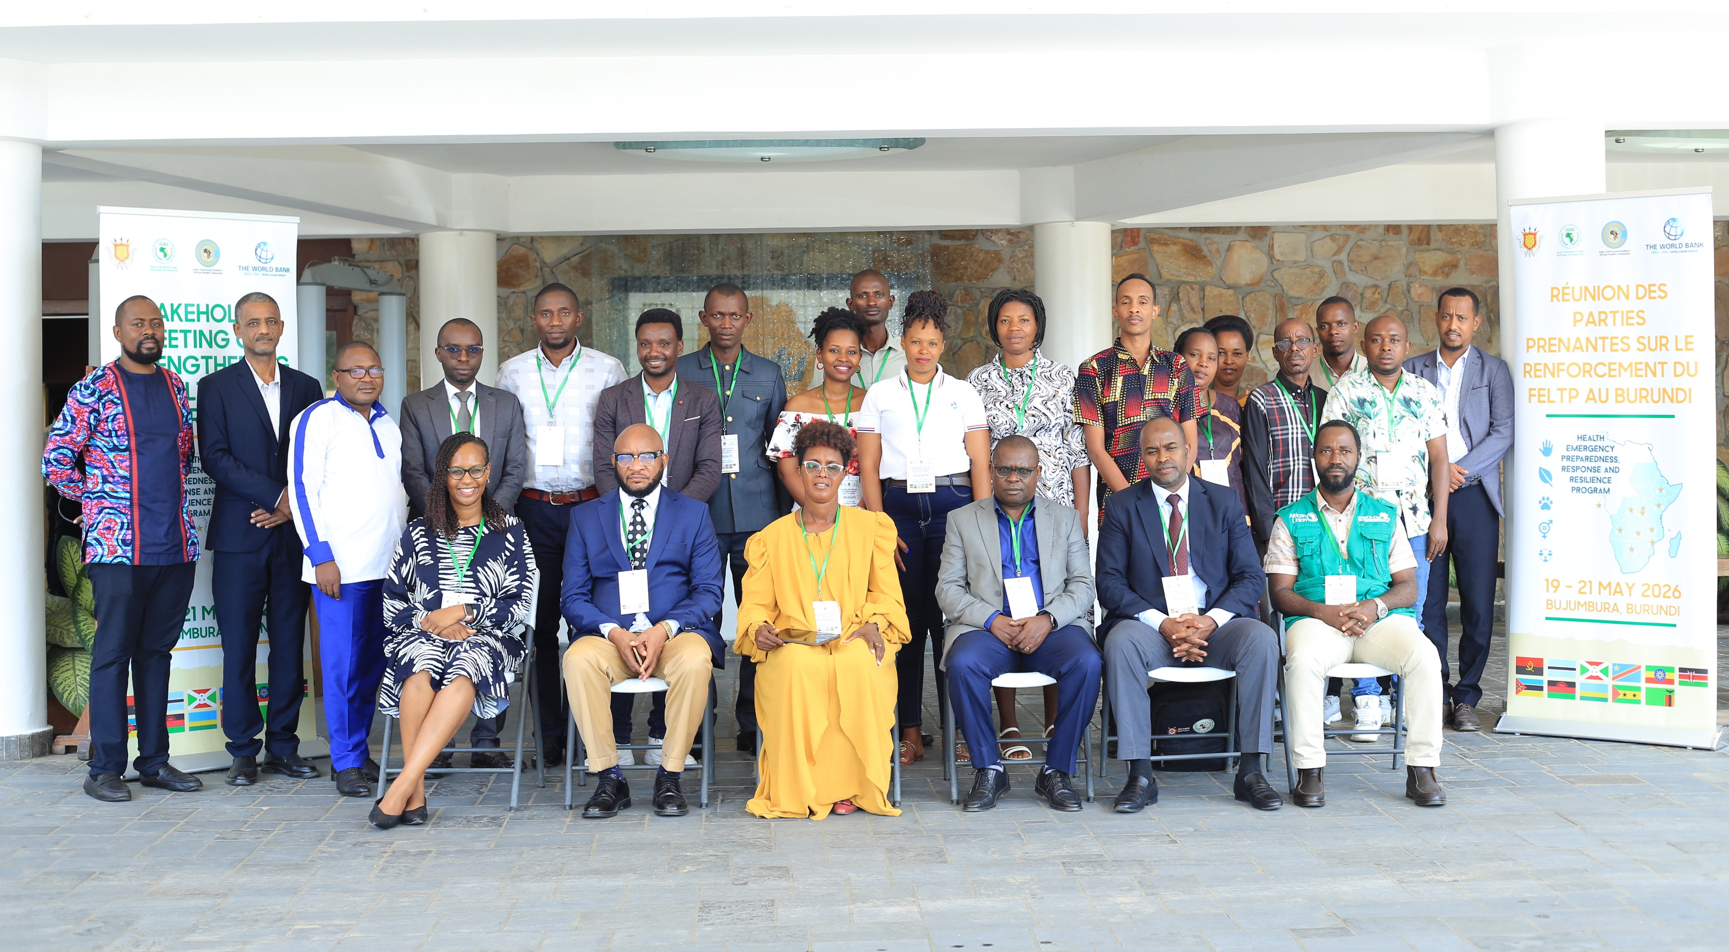
Sub-component 1.2: Strengthening Health Workforce Development
Progress and Achievements
FETP Stakeholder Meeting, 19th – 21st in Bujumbura, Burundi

Slide 15
Sub-component 1.2: Strengthening Health Workforce Development
Support Burundi - MOH to establish I- FETP program:
Convened stakeholder meeting for FETP
  Stakeholders: AFENET, FAO, WHO and AFCDC attended alongside the MOH and other line sectors; 19-21st May, 2026.
  Technical Working Group (TWG) formed to fast track the discussion
  FETP Steering Committee to be established and a meeting to be convened in Bujumbura
  Launch the first cohort of the Intermediate FETP (I-FETP) in October, 2026
  MOH STP requested for TA - focused on training the trainers and mentors
Learning Mission for STP, Burundi and Malawi planned to Ethiopia for experience sharing
Virtual review and validation of the I-FETP Curriculum conducted: Lessons from implementation of the revised curriculum and further reviews after the TOT training done in 2025, recommendations
  Need to finalize contents; AMR and IPC
  Integration of the 7.1.7 in the I-FETP
  Need for Climate and Health contents / modules to be developed and integrated in the I-FETP module progressively

Slide 16
Sub-component 1.2: Strengthening Health Workforce Development
TA – Requests focused on supporting operationalization of the I-FETP revised curriculum
  Ethiopia confirmed that they have initiated operationalization of the IFETP program through cluster training and require training on a Quality Assurance and climate – Health technical area
  STP scheduled to start the inaugural I-FETP in January 2027, requested for training of mentors and trainers and also convening of the steering committee meeting
  Malawi requesting for TA focused on training of the Trainners and Mentors on the QA and additional contents
Follow up meeting with STP to discuss Actions from the Stakeholder Meeting in 2025 and towards establishment of the FETP program in the country
  Virtual engagement conducted and a TWG formed to fast track the discussion
Virtual Meeting with the STP conducted:
  Review FETP Implementation timelines and support through TA
  Plan for Supporting establishment of Steering committee in Q 4
  Organize National Workshop for Trainers and Mentors before commencement of the I-FETP

Slide 17
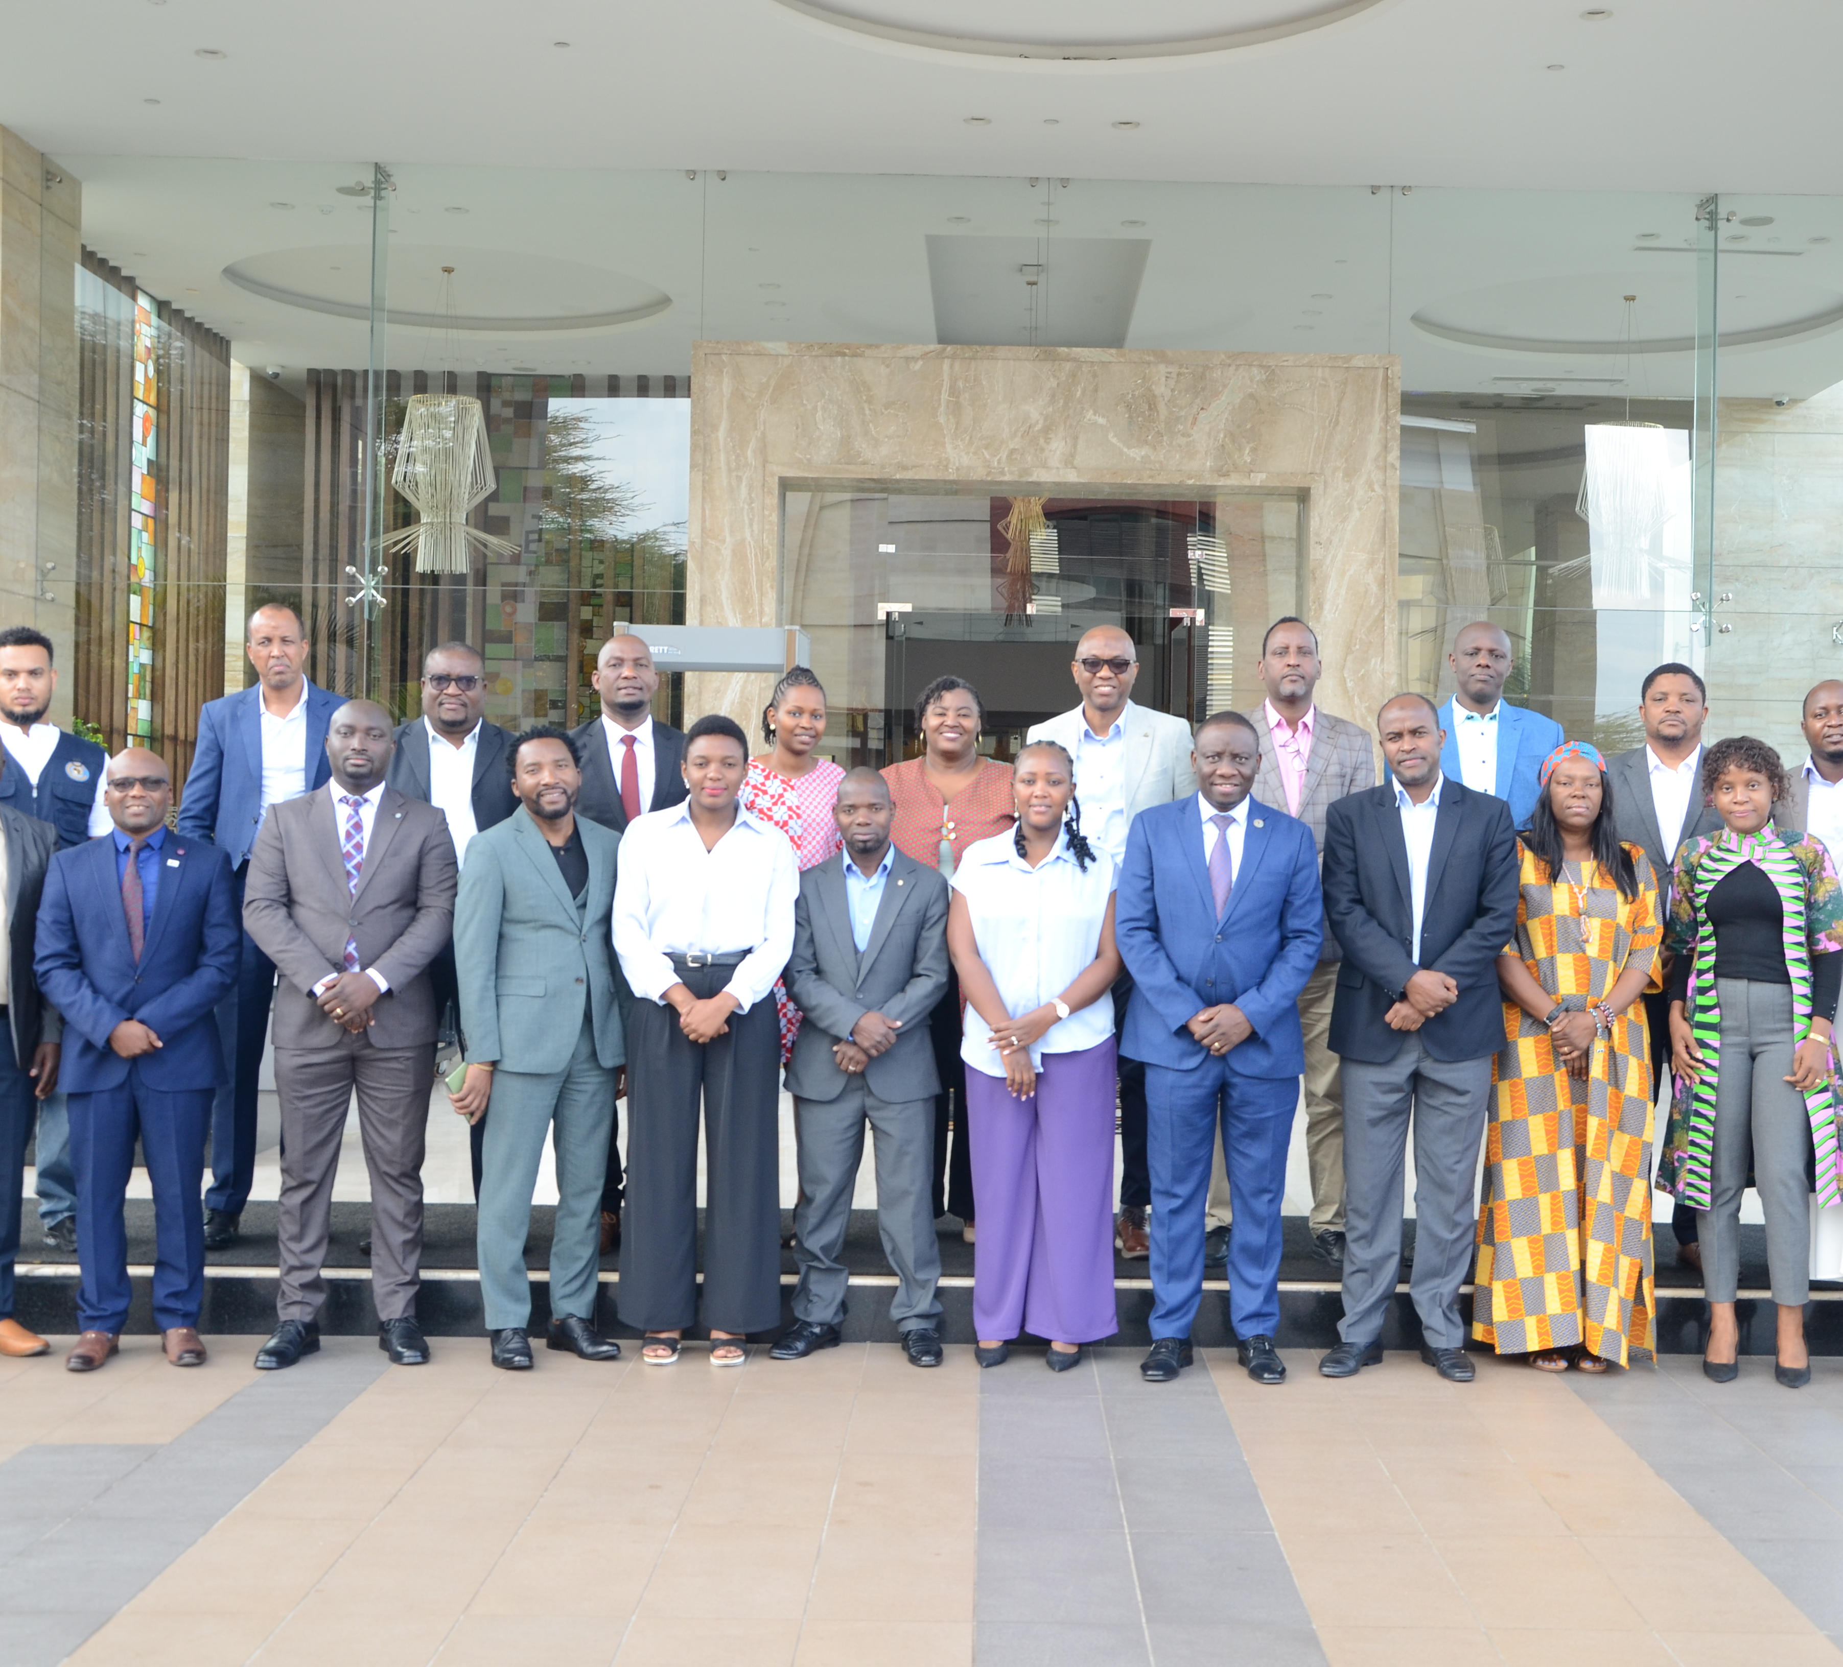
Integration of NCD into the Frontline FETP Program Training:
- IGAD supported workshop aimed at customization of the Frontline FETP training curriculum to strengthen NCD surveillance

Slide 18
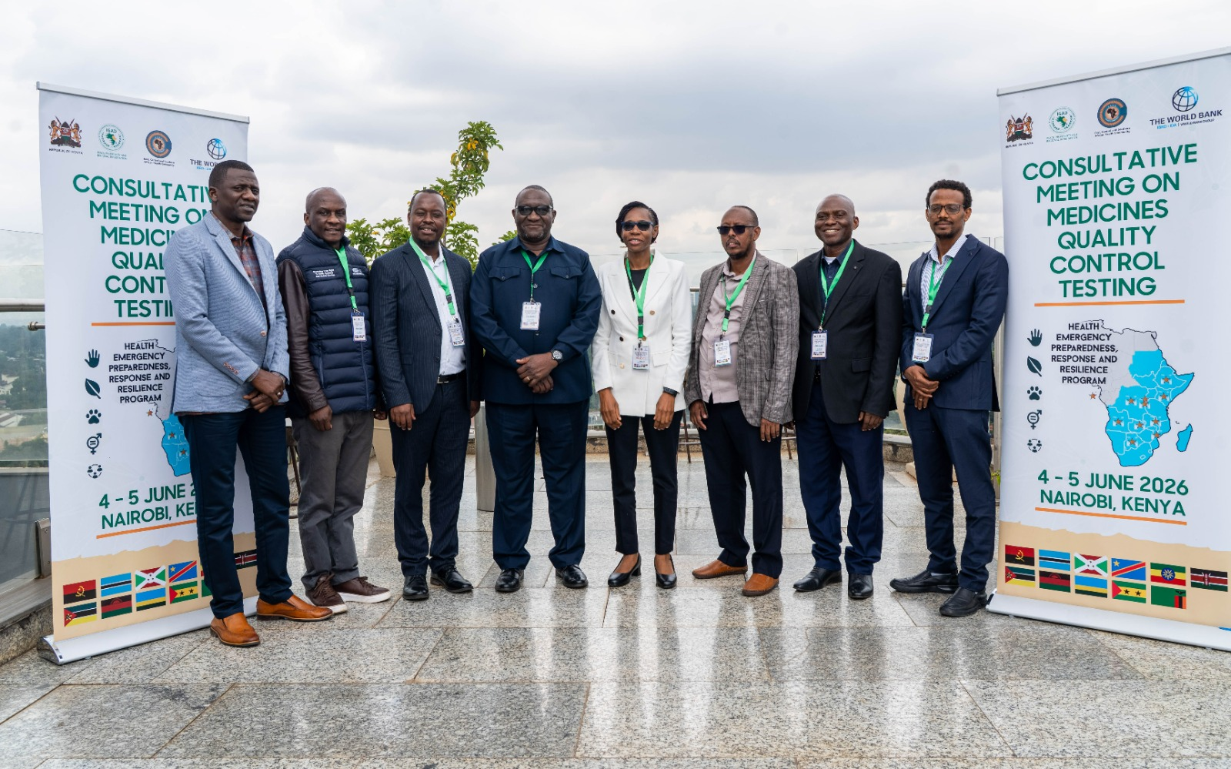
Achievements
Component 1:3
Supporting Access to Quality Health Commodities, Including Building Capacity for Local Vaccine and Pharmaceutical Manufacturing

Slide 19
Local Vaccine and Pharmaceutical Manufacturing
Operationalized the Community of Practice (CoP) on local health manufacturing through quarterly meetings of the CoP and the sub-working groups (SWGs)
  On-going work on draft knowledge products and technical documents through virtual interaction
Supported the Ethiopia- Kenya Exchange visit on vaccine manufacturing which facilitated Knowledge exchange, and generated institutional commitments on vaccine technology transfer, GMP and building manufacturing capacity
Strengthened Intellectual Property (IP) licensing and technology transfer for medical manufacturing through training of 80 regional experts (manufacturers, NRAs, MOH and National IP officers)

Slide 20
Local Vaccine and Pharmaceutical Manufacturing
Commenced recruitment of Pharma Manufacturing SMEs for the Intellectual Property Management Clinic (IPMC) program in collaboration with WIPO
Supported operationalization of the EFDA Quality Control Laboratory as regional reference Laboratory for quality control testing through regional consultations on the Terms of references (TORs)

Slide 21
Sub-component 1.4: Cross-Border Health collaboration and continuity of essential health services
Prepared draft roadmap for Gender and Equity integration in the cross-border activities
Participated in the high-level meeting on multi-country cross border cooperation, collaboration and coordination through Regional MOU in Brazzaville 4th - 5th May
  Two virtual meetings with Ethiopia and Kenya as well as South Sudan to improve cross border collaboration/MOU
Advanced preparations for 3 national advocacy workshops consultations for Kenya, Ethiopia & Burundi (July & August) for the Regional cross border MOU and advocacy for revision of service package
Analyzed data of CB health facility assessment for availability of EHS at 2 PoEs Moyale & Busia. Analysis results presented in Surveillance COP and will be dissemination to country stakeholders during the advocacy meetings.
Prioritized activities to prepare and respond to EVD outbreak at cross border settings

Slide 22
Achievements Component 2
Improving Early Detection of and Response To HEs Through a Multisectoral Approach

Slide 23
Sub-component 2.1: Strengthening collaborative regional and national Multisectoral disease surveillance and laboratory systems capacity
Laboratory Networking
The TOR was approved by the Word Bank and IGAD
Short listed of the potential candidates done
Selection to be finalized in the due course
Strategic workshop on Collaborative Surveillance
Numerous virtual engagement conducted with the partner organizations to co design/ co – create objectives and model of the training
Partners; RTSL, WHO- AFRO and World Bank team
Gates Foundation expressed interest to collaborate
The meeting postponed due to concerns on EVD, however IGAD will continue engaging with the World Bank to finalize the workshop modalities, implementation approach, and delivery arrangements

Slide 24
Sub-component 2.2: Supporting Emergency Management and Coordination
Convening of the NBW Workshop for Rwanda:
  This activity was planned to be implemented in collaboration with various partner organizations: FAO, WHO, WOAH and ECSA HC
  Concept note developed with approval obtained from the World bank
  Meeting Host: Rwanda RBC and taking lead in the implementation of the activity with technical and financial support from IGAD and partners
  The workshop postponed as a result of the EVD outbreak in the region, and that most of the team leads for various key sectors / units in the MOH/RBW and livestock are engaged in the preparedness efforts

Slide 25
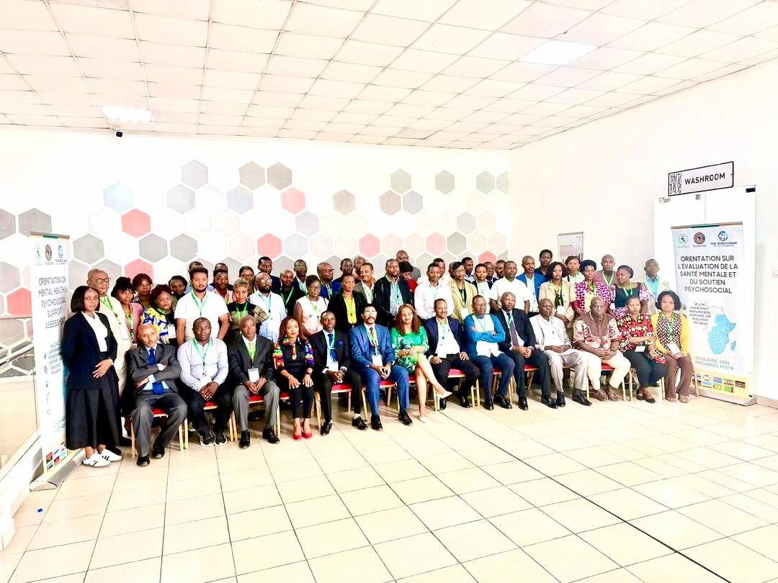
Sub-Component 2.3
Supporting Integration of Mental Health and Psychosocial Support (MHPSS) in the Health Emergency Preparedness and Response and in Cross-border Programming

Slide 26
Sub-component 2.3: Supporting integration of NCDs and Mental Health
Situational assessment on MHPSS system in eight MPA participating countries
  Developed ToR and established Local research team (24) with three members in each country (24)
  Customized the regional protocol to country context and IRB submission forms of protocol for all the eight countries.
Ethical Approval obtained: 6/8 (75%).
  Full Ethical approval obtained for five study participating countries: STP, DRC, Burundi, Zambia and Kenya.
  Conditional approval for Rwanda.
  Under review: two (Ethiopia and Malawi)
Deployed 32 data collectors in the eight participating countries (18 M & 14 F)
Provided two days orientation on the protocol, Data collection tools, techniques and facilitation of GFD and Ethics compliance to 54 data collectors and local research team ( 33 M and 21 F)
Data collection: Out of the five with full Ethical approval, three countries started data collection

Slide 27
Sub-component 2.3: Supporting integration of NCDs and Mental Health
COP on NCDs and Mental Health
  Convened virtual COP meeting on NCD&MH on 24 June with the aim to exchange knowledge and lessons on:
  2025 STEP Survey Results: Presentation of findings from Burundi and Ethiopia.
  Specialized Data Review: Analysis of the Mental Health component of the 2025 STEP survey in DRC.
  Thematic Knowledge Sharing: A review of experiences and challenges regarding Child & Adolescent Mental Health, led by Rwanda.
Peer learning mission on NCD and Mental Health to Rwanda:
Preparation for visit to acquire experiences on NCD, MH and digital health in Rwanda has been started.
  Concept note for the mission developed and shared with the Rwanda team.
  Checklist for the experience sharing visit prepared and shared with .
  Received Confirmation from RBC.
  The experience sharing visit to Rwanda will be held from 20-24 July 2026

Slide 28
Component 3: Project Management

Slide 29
Subcomponent 3.1 M & E
The IGAD Results Framework was revised as part of the restructuring and the 1st Additional Financing
  2 PDOs and 5 IRIs
Submitted the IGAD bi-annual progress report for the period of July to December 2025 (End of January 2026), and progress report for the period from January to June 2026 will be shared before end of July2026
Supported the Zambia and Botswana ISM mission
Participated in the Mozambique baseline assessment

Slide 30
3.1.2 Enhance stakeholder engagement, strategic communications and information disclosure
Strengthened Programme Visibility & and Brand Positioning
Developed the DRAFT HEPRRP 2026–2030 Communications Strategy and Draft Programme Visual Identity Guidelines, laying the foundation for consistent regional communications.
Enhanced HEPRRP visibility through strategic communications for 6+ regional physical events and 20+ high-level virtual engagements across Member States.
Produced multimedia content including photography, video stories, web articles and social media coverage to showcase programme achievements.
Delivered coordinated event branding, visibility materials and partner recognition that strengthened HEPRRP's regional identity.
Increased digital visibility through website features and social media campaigns reaching thousands of regional stakeholders.

Slide 31
Virtual Meetings Supported
  Virtual meeting of the Community of Practice (COP) on Climate and Health aimed at establishing a collaborative regional platform to strengthen integration of climate considerations into public health systems.
  Community of Practice (COP) on Local Manufacturing meeting to discuss the regional work plan for 2026 and various updates.
  Virtual 4th Community of Practice (COP) Meeting for NCDs and Mental Health focusing on sharing and exchanging knowledge on the 2025 STEP and Mental Health survey results, as well as experiences from the Child Mental Health Program.
  Virtual meeting on Establishing Local research NCD and Mental Health research discussing preparations for the upcoming NCD and Mental Health research training, including research team nominations, ethics approval processes, translation requirements, logistical planning, and next steps for implementation across participating countries.
  Virtual Meeting to Discuss Endorsement and Operationalization of the I-FELTP Curriculum across the MPA participating countries.
  Virtual meeting to follow up on the GENPAR integration across MPA participating countries (All the 11 Countries.)
  Virtual IGAD and WIPO Training for Regional Stakeholders on Licensing and Technology Transfer for Medical Innovation

Slide 32
Knowledge Management, Learning & Stakeholder Engagement
Supported Knowledge Production and Learning Agenda
Led production of two flagship HEPRRP Quarterly Newsletters (2025 Edition and Jan–March 2026).
Produced the RAC 2025 Outcome Report and 6 thematic Knowledge Products to promote institutional learning and dissemination.
Developed digital communication tools including an online FAQ platform to improve stakeholder access to programme information.
Supported multilingual inclusion by managing virtual meetings with simultaneous interpretation in English, French and Portuguese.
Strengthened knowledge exchange through supporting organizing of Communities of Practice covering Climate & Health, Local Manufacturing, Mental Health, NCDs, Research and FELTP implementation.

Slide 33
Communications and Learning
📑1 Draft Regional Communications Strategy
🎨1 Draft Programme Visual Identity Toolkit
📢 25+ Regional Events Supported (6+ regional physical events and 20+ high-level virtual engagements
📰2 HEPRRP Newsletters Produced
📚 7 Knowledge Products Developed
📸 200+ Photos & Multimedia Assets Created (Event documentation across the region)
🌍 20+ Virtual Regional Meetings Managed
🌐Translation : English | French | Portuguese
🤝 11 Member States Supported
📈Enhanced Programme Visibility| Knowledge Sharing and Stakeholder Engagement

Slide 34
Subcomponent 3.2 learning Agenda
Operationalization of the adopted learning agenda
Focus on 4 flagship topics
  Collaborative Surveillance
  Digital Health
  Local Manufacturing
  Workforce Development
The learning agenda endorsed by RAC in 2025 paving way for implementation
COPs is the main operationalization approach/platform
Further consultation ingoing to strengthen implementation of the learning agenda

Slide 35
Subcomponent 3.2 Gender and Equity driven HEPRR
Deployment of Health Equity Specialist is concluded
Customized regional technical support to MPA countries:
  The Regional GENPAR Training held in Addis Ababa, Ethiopia, in March 2026, brought together participants from 11 MPA countries
  Established a common understanding of GENPAR Toolkit across key capacity areas
  Strengthened understanding of the underlying gender and equity factors
  Enhanced capacity to collect and analyze disaggregated data
  Develop a country-specific action plan
Operationalization the GENPAR Toolkit at country level
  post-GENPAR virtual technical assistance (11 countries) was provided to countries to integrate gender and equity considerations into countries' Annual Work Plans (AWPs)
  Deliver tailored technical support to address country-specific gaps and priorities
  National GENPAR Training of Trainers (ToTs) were delivered in selected countries

Slide 36
Subcomponent 3.2 Gender and Equity driven HEPRR
Operationalization the GENPAR Toolkit at country level
  National GENPAR ToT was successfully conducted in Ethiopia
  Tailored TA was provided to DRC to support the integration of gender and equity considerations into Ebola real-time surveillance and response activities
Challenges
Institutionalization of gender and equity remains at an early stage in many countries.
Sustained political commitment, technical capacity, and dedicated financial resources.
Sex-, age-, and pregnancy-disaggregated data remain limited

Slide 37
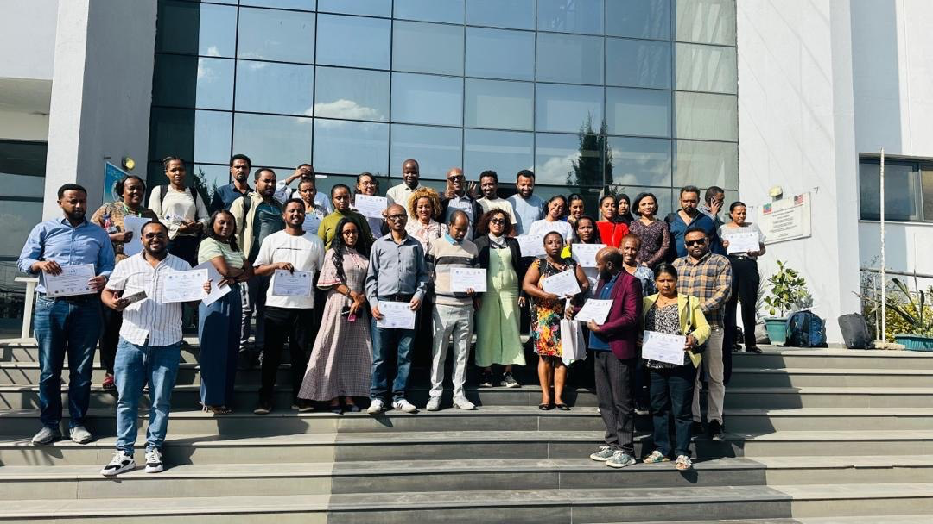
Subcomponent 3.2 GENPAR Ethiopia Country TOT

Slide 38
Subcomponent 3.3 Environmental & Social (E&S)
Operationalization of the GRM committee was done
Orientation and training of the PIU on the E&S, will be organized through the support of the World Bank Specialists

Slide 39
Subcomponent 3.3 Project Management
Development of Five years strategic plan done
Finalized the recruitment of the climate and health expert and start date will be 1st August
Finalized deployment of Health Equity Specialist
Developed draft ToR for the Learning Expert, awaiting discussion during ISM for the next steps

Slide 40
Sub-Component 3.3 Procurement
STEP is updated with regard to the PIU staff recruitment documentation.
The process for the procurement of the vehicle has been postponed based of on IGAD’s management advised and now provided go ahead to finalize the procurement during Q3 2026.

Slide 41
Subcomponent 3.3 Financial Management
Disbursement | US$
Overall budget (Grant amount) | 19,000,000
Cumulative disbursement (up to June 2026) | 8,714,663
Disbursement rate: (disbursement vs. overall budget) | 46%
Expenditure | US$
Funds received | 8,714,663
Cumulative expenditure (up to June 30, 2026) | 6,024,801
DA balance (June 30, 2026) | 2,689,862
Burn rate: (expenditure vs. funds received) | 69%

Slide 42
Lessons Learned/Best Practices
Strengthening multi-sectoral collaboration through increased engagement of other sectors particularly Animal and Environment sector
Cross-Country Peer Learning and Benchmarking: Significant value in comparing approaches, sharing real case experiences, and benchmarking visits
Cross-border investment is critical to prepare and respond to health emergencies in PoEs such as EVD
Regional investment can add value to the countries’ efforts
  Complementarity of interventions at the regional and country level (eg; GMP towards ML3)
Engagement of peer experts from countries through TA to enhance cross pollination of best practices
Engagement of RECs in various MPA activities strengthening the coordination and collaboration to enhance regional health security in Africa

Slide 43
Challenges
Low implementation rate in 1st half of the 2026 because of delay in approval of annual work-plan and budget and the restructuring process .
Guidance on country specific technical assistance requests which can be addressed with regional resources
Domestication of the lessons learned/best practices and inclusion in the national action plan

Slide 44
Possible Solutions
Accelerated plan (in Q3&4) to expedite the implementation of the unexecuted activities in first half of 2026.
Early approval of AWP&B, maximum by Q1
Enhance virtual engagements with project stakeholders for implementation of various activities including the 3 COPs.
Sharing of the ISM reports of the MPA countries to identify the combined challenges for specific technical assistance and lessons learned to be documented by the regional institutions

Slide 45
RAC: Suggested Key Areas of Improvement for Future Meetings
Enhancing Participation, Engagement and Interactivity:
Strengthening Time Management and Streamlining the Agenda
Refining Panel Design – Fewer Panellists, Shorter Panels, Clear Moderation
Broadening Stakeholder Inclusion and Ensuring Balanced Representation
Strengthening Logistics, Communication, and Meeting Environment:
Improving Preparation, Pre-Meeting Processes, and Clarity of Expectations
Maintaining Quality Content while Increasing Technical Depth and Practical Relevance

Slide 46
Suggested Topics for RAC
Discussion on climate and health nexus
Domestic financing for local manufacturing
Cross border preparedness and response
Workforce development for preparedness and response to Health Emergencies

Slide 47
Updates of Results Indicators
Project Development Objectives | Target 2026 | Current Value | Remarks
Percentage of countries that have signed protocols to promote cross-border response (Percentage) | 55% | 0 | IGAD is supporting 3 countries to enhance the endorsement of the multicounty CB MOU for HEs
Proportion of MPA countries that have adopted CoP-generated regional knowledge products (guidelines, tools, or frameworks) into national policies, plans, or implementation practices (Percentage) | 50% | 0% | One product from COP on NCDs which was presented, discussed and agreed in COP meeting
Intermediate Indicators (IRIs)
Number of IGAD-supported CoP-generated regional knowledge products (including guidelines, policy briefs, tools, frameworks, and case studies) (End target: 12) | 3 | 1 | There are 1 products from NCD/MH COP under finalization and design
Number of countries supported to revise their essential health services package (End target: 8) | 2 | 2 | ET, Zambia revised, 3 national advocacy meetings scheduled for July –Aug to support revision/utilization of EHS (Ethi, Kenya, Burundi)
Number of countries supported to operationalize the revised I-FETP curricula (End target: 5) | 1 | 1 | ET, (Malawi is planned this year)
Number of countries supported to strengthen their medicines regulatory systems towards attaining ML3 based on WHO GBT (End target: 4) | 1 | 0 | ET (achieved before setting this indicator)
Number of gender-differentiated health risk profiles developed for major diseases, including climate sensitive diseases (End target: 4) | 1 | 0 | Review of existing profiles will be conducted and publish before developing new profiles

Slide 48
Status of Actions from 3rd ISM
Areas | Agreed actions to be undertaken to resolve critical issues | Responsible party | Timeline | Status Done/In process with new expected completion date/Pending
Strategic work planning and delivery | WB to review the IGAD Annual Work Plan and Budget submitted on January 21, 2026. | WB | February 5, 2026 | Done
Regional learning agenda & COPs | Define clear terms of reference for proposed regional learning coordinators and clarify their institutional relationships with CoPs, PIUs, and regional and country stakeholders. | ECSA-HC, IGAD | January 31, 2026 | Done – we need to get back to you
 | Share a concise menu of available technical assistance IGAD (particularly helpful for new countries) | IGAD | February 10, 2026 | Shared a revised menu of TA
M&E | Revised RF table to be finalized and agreed upon | World Bank, ECSA-HC, IGAD | January 31, 2022 | Done
 | IGAD to share status and methodology of lagging indicators based on the agreed RF table | IGAD | February 9, 2026 | Discussed earlier with Alejandro and sharing the draft document with this update

Slide 49
Status of Actions from 3rd ISM
Areas | Agreed actions to be undertaken to resolve critical issues | Responsible party | Timeline | Status Done/In process with new expected completion date/Pending
FM | Include prospective budgeting elements to current budget monitoring tools | FM specialist, Procurement | February 15 2026 | Done. IFRs submitted in 2025 and 2026 include prospective budget elements
 | Submit the most recent internal audit report (s) to the WBG | FM specialist | Immediate | Done. The most recent Internal Audit report for 2025, along with remedial action plan, was submitted to the Bank on July 6, 2026
 | Increase frequency of IFR submission in required format | FM specialist | Immediate | Done. IFRs are submitted quarterly per the FA using agreed upon format. These have been reviewed and accepted by the Bank. Withdrawal Applications are also submitted quarterly based on IFRs.
 | Submit audit report for period ended 31st December 2025 | FM specialist | 30th June 2026 | Done. External audit report for 2025 was submitted to the Bank on July 3, 2026.

Slide 50
Status of Actions from 3rd ISM
Areas | Agreed actions to be undertaken to resolve critical issues | Responsible party | Timeline | Status Done/In process with new expected completion date/Pending
Procurement | Update STEP with signed contracts and documents related to the contract's implementation | Procurement Specialist | February 28, 2026 | STEP is updated except procurement of the vehicle has been postponed based on IGAD’s management advised to be procured during Q3 2026
 | Add in STEP all procurement activities approved in AWP | Procurement Specialist | When AWP is approved | All activities for 2026 are uploaded

Slide 51
THANK YOU!

